Slide 1
Evaporator Design Comparison
Modified AHT
Original AHT
from Lidl (AHT new design?)
2.1
1.1
1
2.1 IN
1.1 IN
1
2.1 IN
1.1 IN
3.1
2
3.1 IN
2
3.1 IN
3
3
3.4
1.4
4
4
3.4
2.4
3.4
1.4
5
5
1.4
2.4
6
2.4
6
3.5
3.5
3.5
7
7
2.5
8
2.5
8
2.5
3.8
3.8 IN
9
3.8
9
1.5
1.5
2.8 IN
10
1.5
2.8
10
11
11
1.8
3.9
1.8 IN
1.9
12
1.8
1.9
12
2.8
1.9
13
13
2.9
3.9
2.9
3.9
14
14
2.9
3.12 OUT
3.12 OUT
15
1.12 OUT
3.12 OUT
15
2.12 OUT
1.12 OUT
16
2.12 OUT
1.12 OUT
16
2.12 OUT

Slide 2
Evaporator Design Comparison
Original LIDL design
modified LIDL design
1
2.1 IN
1.1 IN
1
2.1
1.1
2
3.1 IN
2
3.1
3
3
4
3.4
2.4
4
3.4
2.4
5
1.4
5
1.4
6
3.5
6
3.5
7
7
8
2.5
3.8
8
2.5
3.8fIN
9
1.5
9
1.5
10
10
11
1.8
3.9
11
IN 1.8
3.9
12
2.8
1.9
12
IN 2.8
1.9
13
13
14
2.9
14
2.9
15
1.12 OUT
3.12 OUT
15
1.12 OUT
3.12 OUT
16
2.12 OUT
16
2.12 OUT

Slide 3
Evaporator – AHT original design
Evaporator left side
Evaporator right side
1.2
2.2
2.1
1.1
3.2
3.1
1.3
3.3
2.3
3.4
1.4
3.6
2.4
3.5
2.6
2.5
3.7
3.8
2.7
1.6
1.5
2.8
1.10
1.7
2.10
1.8
1.9
3.10
2.9
3.9
3.11
3.12
1.11
2.11
2.12
1.12

Slide 4
2.12
2.9
1.8
1.5
3.8
2.4
3.4
3.1
2.1
Evaporator – AHT original design
1.12
3.12
3.9
1.9
2.8
2.5
3.5
1.4
1.1

Slide 5
AHT original evaporator with changed piping
Evaporator left side
Evaporator right side
1.2
2.2
2.1
1.1
3.2
3.1
1.3
3.3
2.3
3.4
1.4
3.6
2.4
3.5
2.6
2.5
3.7
3.8 IN
2.7
1.6
1.5
2.8 IN
1.10
1.7
2.10
1.8 IN
1.9
3.10
2.9
3.9
3.11
3.12 OUT
1.11
2.11
2.12 OUT
1.12 OUT

Slide 6
Evaporator – from Lidl (AHT new design?)
Evaporator left side
Evaporator right side
1.2
1
2.1
1.1
2
3.1
3
4
3.4
2.4
1.3
5
1.4
6
3.5
7
8
2.5
3.8
1.6
9
1.5
10
1.7
11
1.8
3.9
1.10
12
2.8
1.9
13
14
2.9
1.11
15
1.12
3.12
16
2.12

Slide 7
Evaporator – modiefied LIDL design
Evaporator left side
Evaporator right side
1.2
1
2.1
1.1
2
3.1
3
4
3.4
2.4
1.3
5
1.4
6
3.5
7
8
2.5
3.8
1.6
9
1.5
10
1.7
11
1.8
3.9
1.10
12
2.8
1.9
13
14
2.9
1.11
15
1.12
3.12
16
2.12

Slide 8
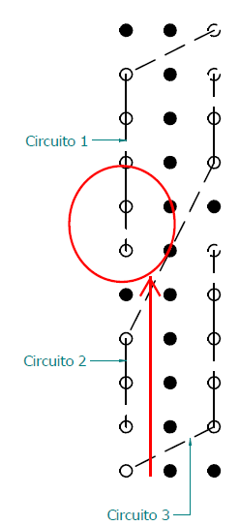
Refrion Proposal

